Slide 1
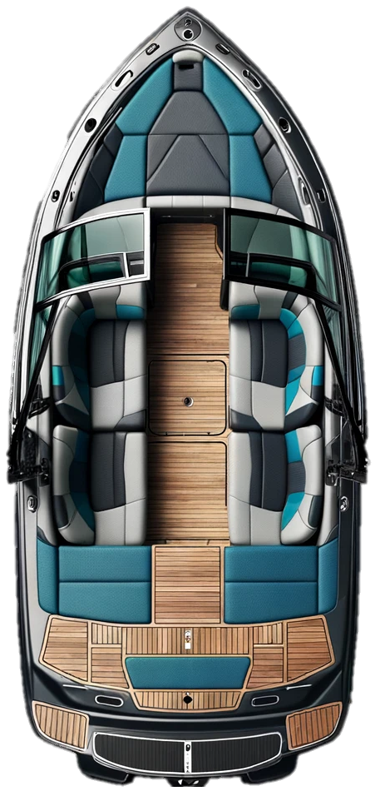
Center Tank
Port Tank
Strbd Tank

Slide 2
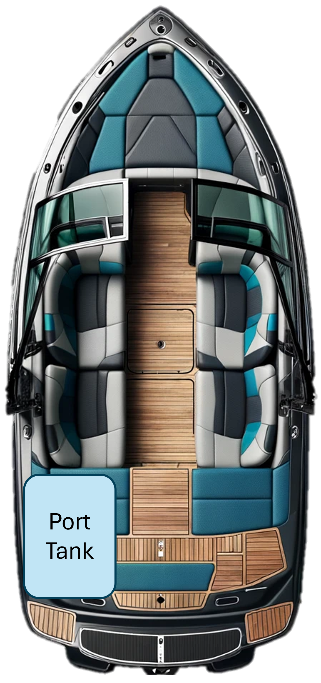

Slide 3
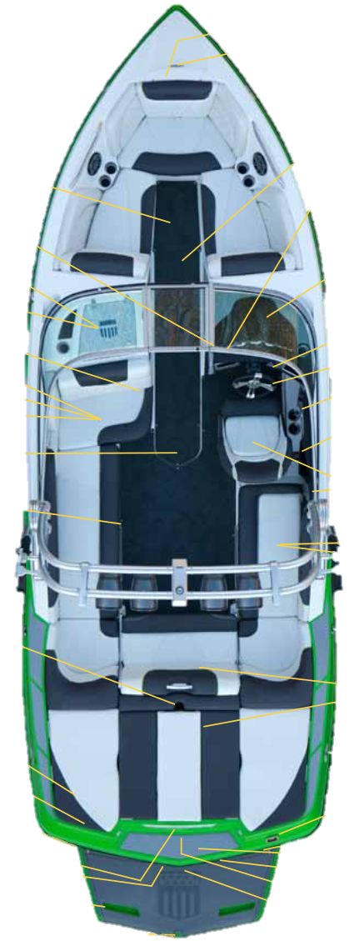
Center Tank
Port Tank
Strbd Tank

Slide 4
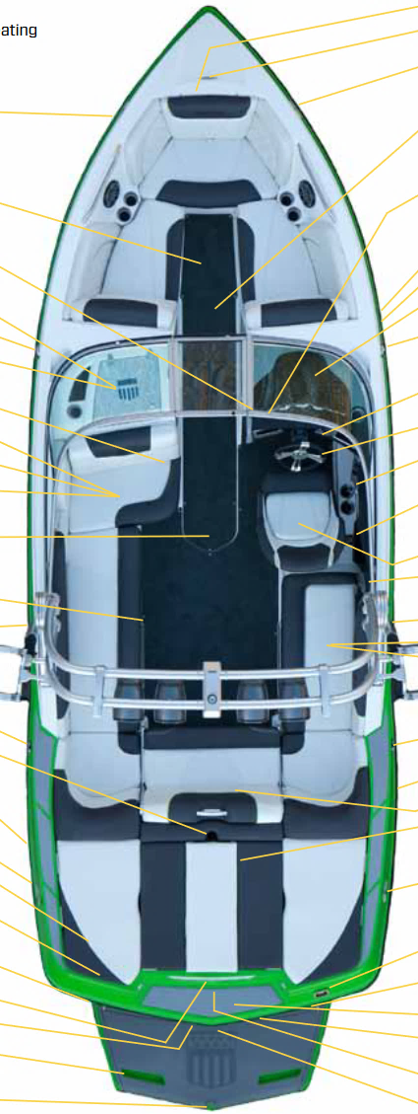
Port Tank
Strbd Tank

Slide 5



Slide 6
Rudder
Rudder

